Slide 1
Natural Language Processing: A Primer
Materials: https://bit.ly/2CEWULr
Sign in: https://bit.ly/32EzHUg

Slide 2
What this workshop will be:
A dive into the tools used for Natural Language Processing
Tokenization
Lemmatization
POS tagging
Entity Recognition
Dependency Parsing
Putting the tools together using a pipeline!

Slide 3
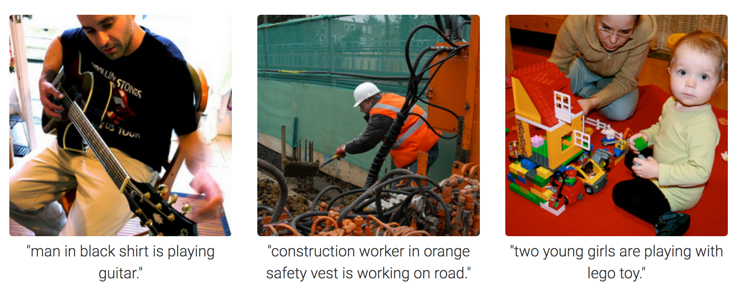
WHERE HAVE I SEEN THIS APPLIED?

Slide 4
WHY NLP IS HARD

Slide 5
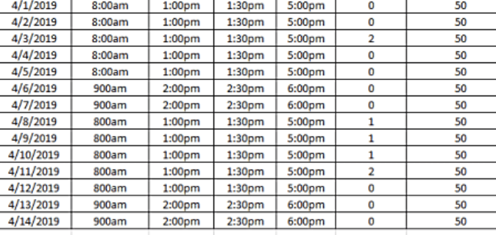

Structured vs Unstructured Data

Slide 6
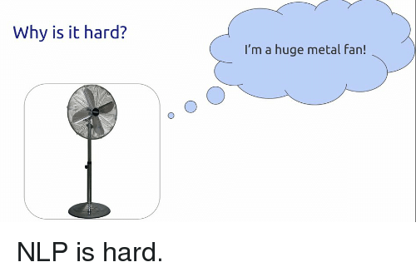
The curse of context

Slide 7
ONTO THE TOOLS!

Slide 8
SENTENCE SEGMENTATION
Break the text apart into separate sentences
Can be as simple as splitting a string by spaces or punctuation marks.
Modern NLP pipelines often use more complex techniques to handle irregular formattin

Slide 9
“There are bakeries in France. The bakers speak French. They sell bread.”
There are bakeries in France.
They sell bread.
The bakers speak French.

Slide 10
WORD TOKENIZATION
Process each sentence at a time and break into tokens.
Need not just be words.
In English, however, we split by space and include punctuation marks as separate tokens.

Slide 11
“London is the capital and most populous city of England and the United Kingdom.”
………..
London
is
the
United
Kingdom

Slide 12
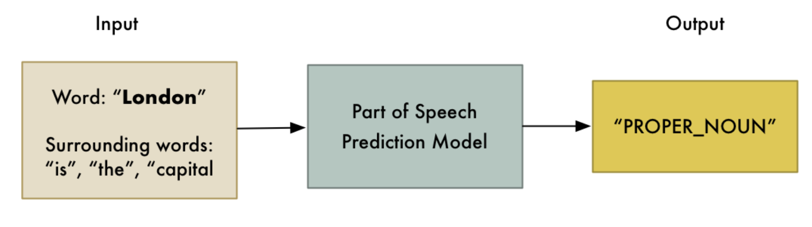
PARTS OF SPEECH TAGGING
Assess each token’s role in a sentence by feeding into pre-trained part-of-speech classification model.
Completely statistical. Does not understand inherent meaning the way humans do.

Slide 13
TEXT LEMMATIZATION
Words appear in different forms.
“I had a pony.”
“I had two ponies.”
Both talking about ponies, but using different inflections! Helps to know the base form of each word.
This is known as lemmatization: figuring out the lemma of each word in the sentence.
If you were engineering a lemmatization tool, which data structure would you use? Remember, we want fast lookups!

Slide 14
I have a pony
pony
I had ponies

Slide 15
IDENTIFYING/REMOVING STOP WORDS
Frequent words like “a”, “the” are flagged as stop words.
Introduce a lot of noise during statiscal analysis. Best that we filter them.
Generally a hardcoded list of stop words. But, can vary depending on the application. Well written libraries are dynamic in this sense.

Slide 16
Stop Words
“and”
“a”
“the”
“it”
What is wrong/challenging with this?

Slide 17
DEPENDENCY PARSING
Represents relations between words in a sentence.
Build a tree that assigns a single parent word to each word in the sentence.
Can also predict the relationship between two words.
Leaves us with a graph-like structure where edge “weights” represent parts of speech and nodes can be both words and relations.

Slide 18
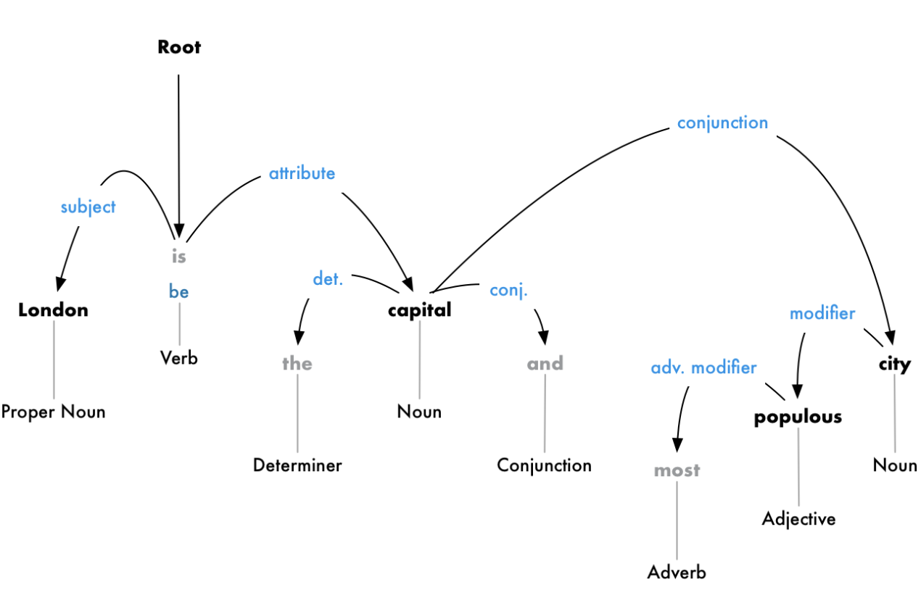
VISUALIZING DEPENDENCY PARSING

Slide 19

NAMED ENTITY RECOGNITION
First real attempt to extract ideas!
Goal is to detect and label nouns with real-world concepts that they represent. Uses context and a statistical model to guess the type of noun a word represents.
Fix this to be own image

Slide 20
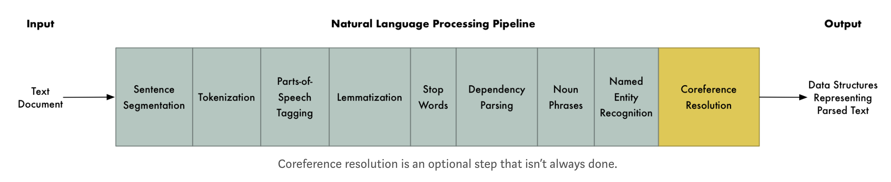
PIPELINES!
Common design pattern in most NLP libraries.
Need arises from the fact that we want to put together all the tools we just learnt.
There is no “correct” ordering of the tools!

Slide 21
INTRODUCTION TO SPACY
NLP library written in Cython. Highly speed-focused.
Known to be highly accurate (one of the best performing dependency parsers in the world)
Plays well with the libraries that we have learnt so far!

